Slide 1
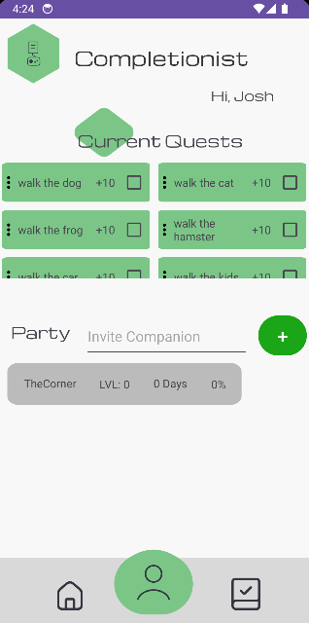
Completionist
By Joshua Dunn, Erik Chodaba, Christopher Madrigal, Burhanuddin Mogul

Slide 2


Pitch
A task manager with much more:
A social aspect so even your friends can help you stay on track
A reward system to help you continue doing tasks

Slide 3
Logout+Sign Up + Friend Invite
FOR CODEPATH SUBMISSION
Overview+Task Creation+XP Gain

Slide 4
Sign In + Push Notifs
FOR CODEPATH SUBMISSION
Friend Accept + Profile Edit

Slide 5

Demo Time!
GIF Links for CodePath Submission
Overview+Task Creation+XP Gain
https://github.com/CS388-Android-App-Team/Codepath-AndroidApp/blob/JoshDunn88-patch-1/Overview%2BTaskCreation.gif
Logout+Sign Up + Friend Invite
https://github.com/CS388-Android-App-Team/Codepath-AndroidApp/blob/JoshDunn88-patch-1/Logout%2BSign%20Up%20%2B%20Friend%20Invite.gif
Sign In + Push Notifs
https://github.com/CS388-Android-App-Team/Codepath-AndroidApp/blob/JoshDunn88-patch-1/SignIn%20%2B%20Push%20Notifs.gif
Friend Accept + Profile Edit
https://github.com/CS388-Android-App-Team/Codepath-AndroidApp/blob/JoshDunn88-patch-1/Friend%20Accept%20%2B%20Profile%20Edit.gif

Slide 6

Roadblocks
Group Coordination - It was difficult to develop a work schedule that allowed parallel work.
Decision Making - With many options for how to implement user features, figuring out which methods would work best together took time.
Settling on Scope - Our initial idea had to be shaved down for time, due to a low level of productivity in the beginning of the project.
Setting up the Databases - This took hours of work to get set up and working and caused a delay to making sure the tasks are saved both online and offline, and app functionality remains.

Slide 7
The Next Steps
More Advanced Statistic Tracking Over Time
Social Feed for Posting About Your Completion (Viewable daily similar to BeReal)
Ability to Give Friends Commendations for Their Progress
Avatars and Profile Customization that Unlocks by Level
Different Game-Themed Themes (Tactical, Hero, Fantasy, etc)
Make it Prettier

Slide 8
Thank you for your time, any questions?

